Slide 1

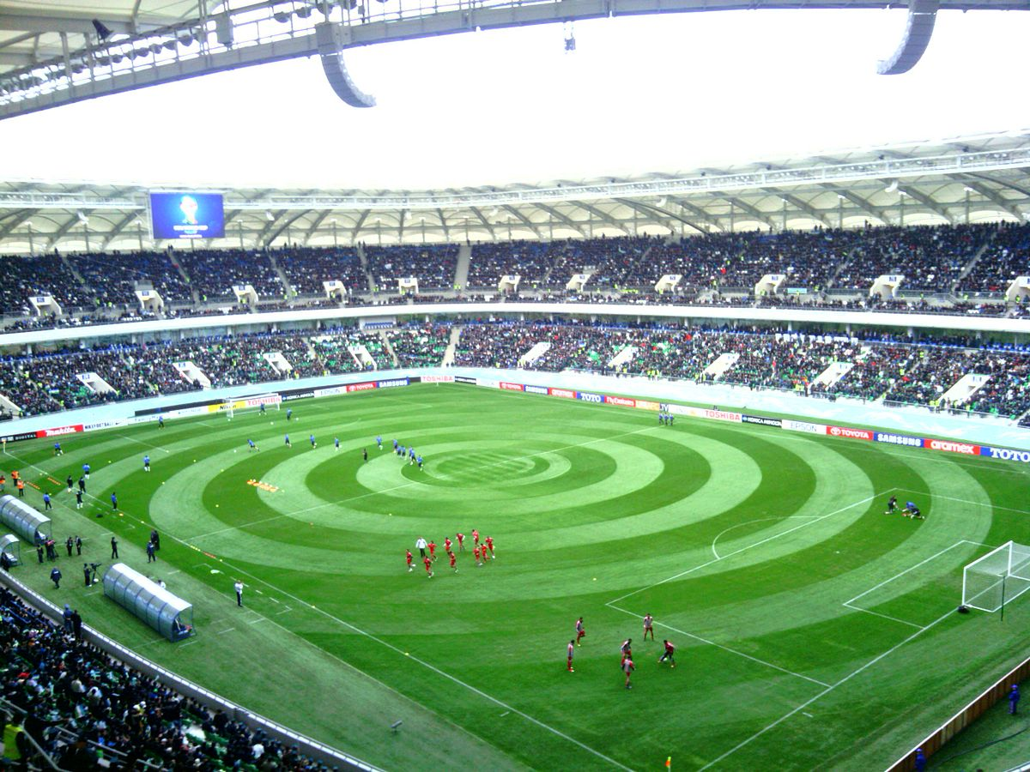
Ticket Reservation System
DEPARTMENT OF CSE & ICE
SOC 3010 - OPERATING SYSTEM

Slide 2


Team members
01
U1610230
Shokhrukhmirzo Mirzakhmedov
U1610001
02
Abbosjon Kudratov
U1610053
03
Boburjon Borataliev
U1610037
04
Aziz Riskulov
U1610030
05
Azizbek Avazov
U1610156
06
Mukhammadrasul Mukhtorov

Slide 3
Outline
Abstract
Introduction & Problem Statement
Project overview
Project Design & Implementation
Results & Discussion
Conclusion

Slide 4
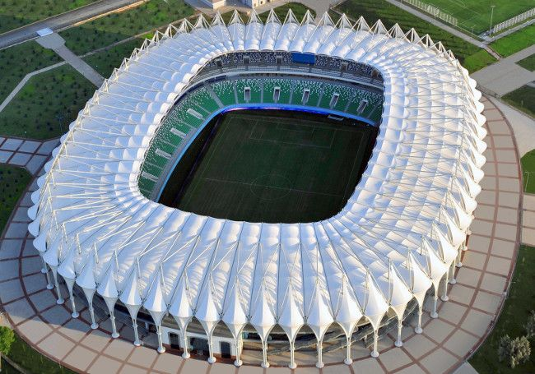
Abstract

Slide 5
Abstract
As we are living in the era of Information Technology, We want to do everything online. Online shopping, Online printing and every service that helps us. One of the most time saving and useful online services for football fans is Online ticket reservation system. Considering the fact that our country has not established this system, we came up with an idea to develop an application which can save our precious time and money when we want to visit football matches.

Slide 6
Problem Statement

Slide 7
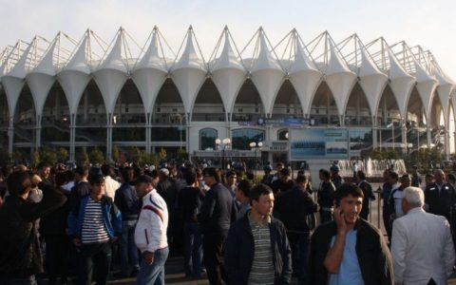
Problem Statement
Main Problems:
No Online Service
Busy Lines
Unexpected Prices for tickets
Ticket Lost

Slide 8
Introduction

Slide 9
Introduction
Who will benefit from our project
Main features of Our project

Slide 10
Project Overview

Slide 11
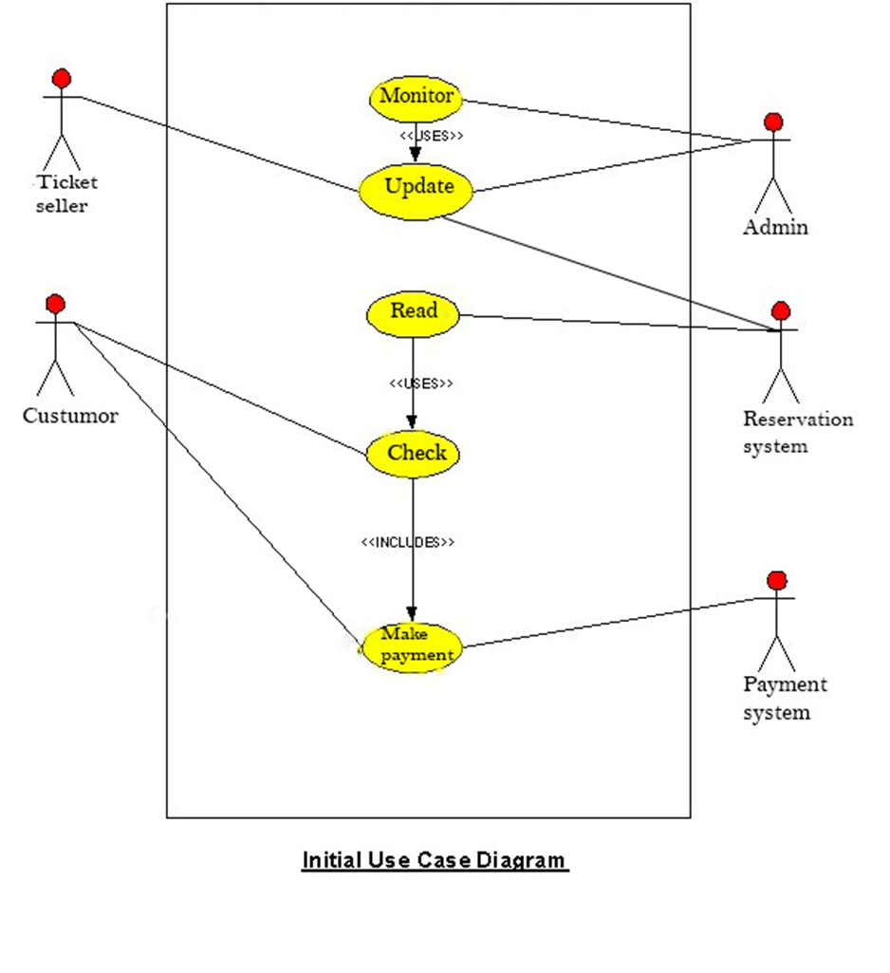
Use Case Diagram

Slide 12
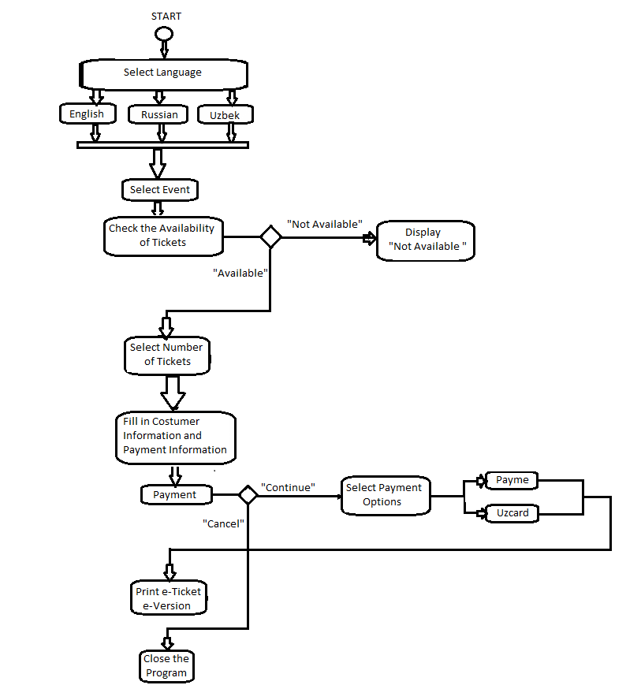
Activity Diagram

Slide 13
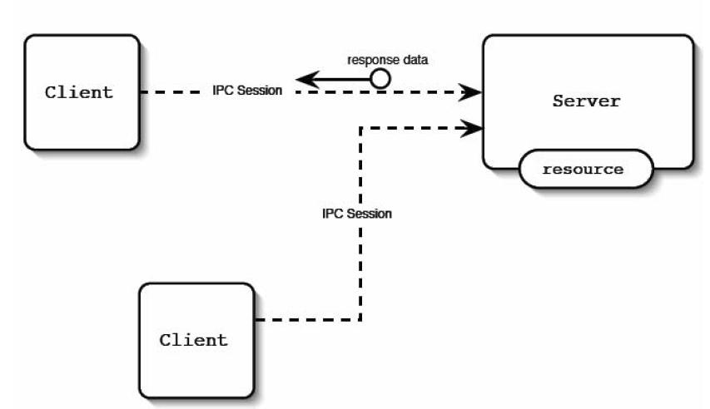
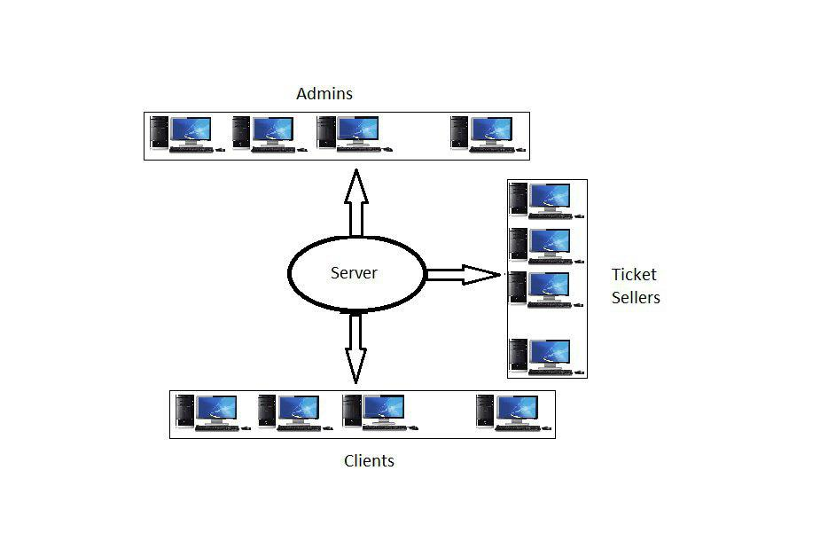
Behavioral Diagram

Slide 14
Design & Implementation

Slide 15
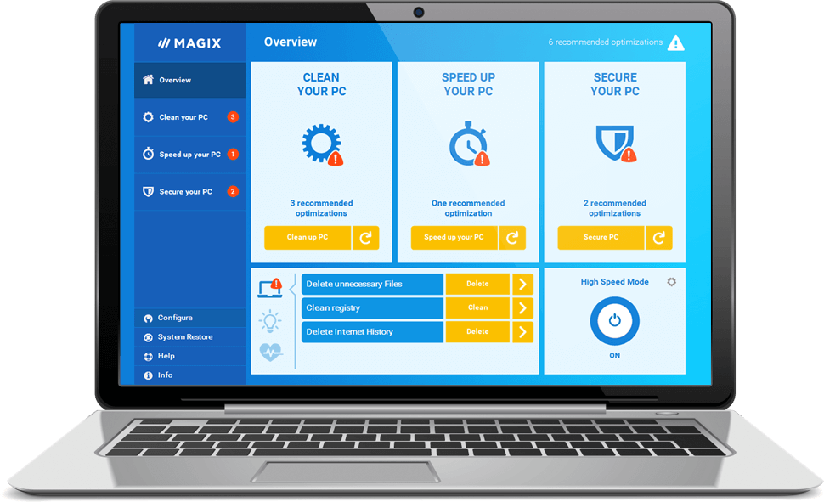
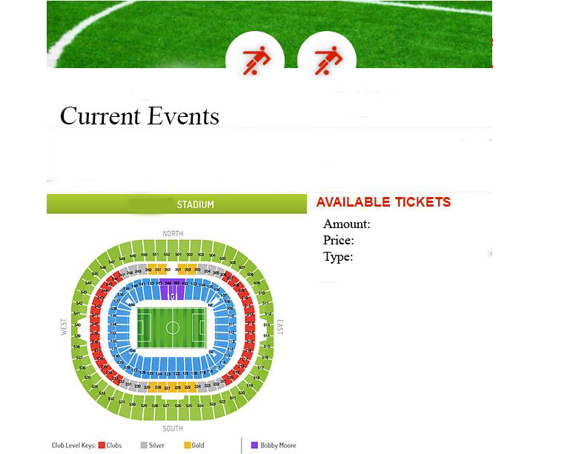
User Interface

Slide 16
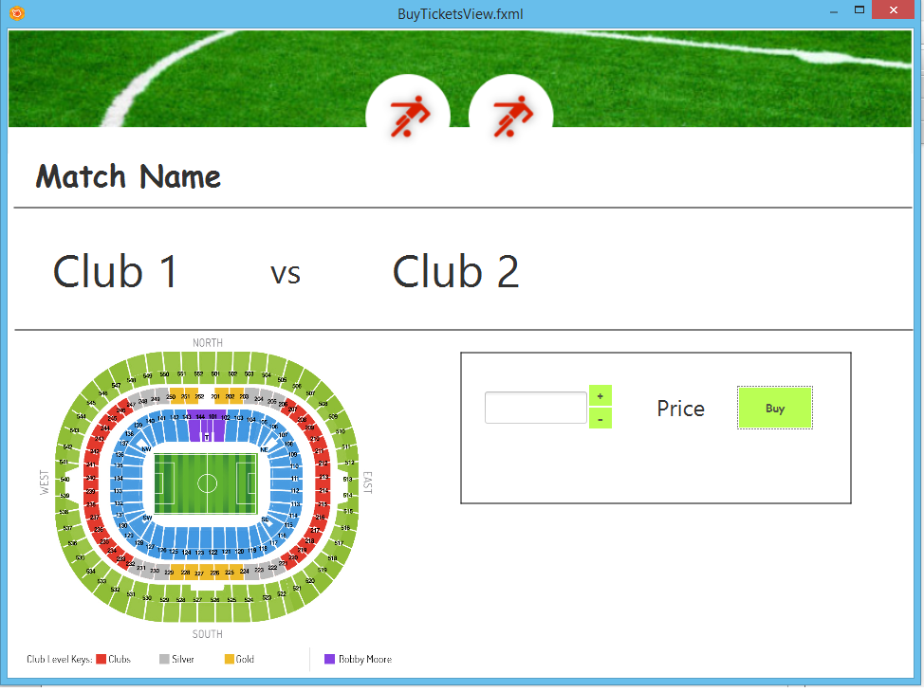
User Interface

Slide 17
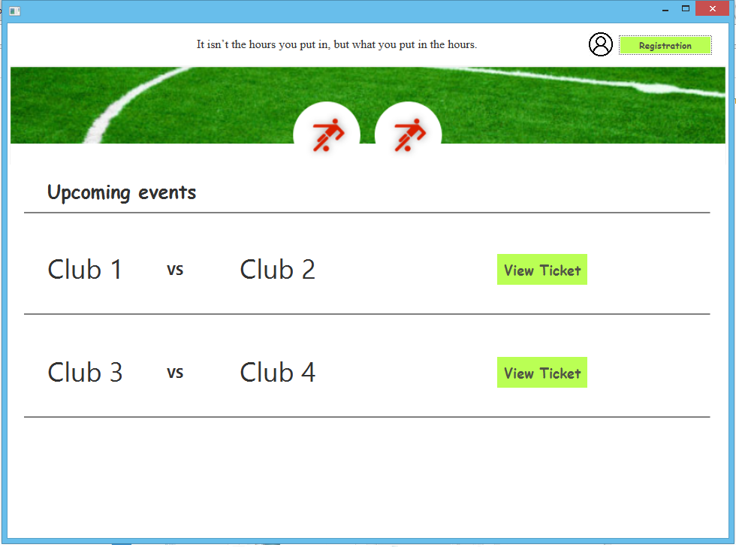
User Interface

Slide 18
Conclusion
In nutshell, We want to implement an online service – Ticket Reservation system which saves times and money of hundreds of people. It helps us avoiding busy lines and loosing our tickets.

Slide 19
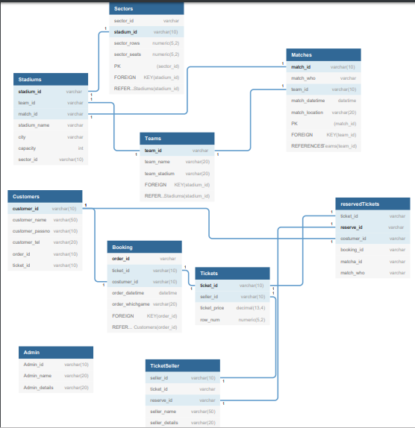
Relational Database

Slide 20




Results & Discussion:How the system works

Slide 21
Project Demo

Slide 22
References
1. Introduction to Socket programming in C using TCP /IP, Panagiota Fatourou
2. Understanding the Linux Kernel, Daniel P. Bovet Marco Cesati, ISBN: 0-596-00002-2
3. https://stackoverflow.com.
4.https://www.ibm.com/support/knowledgecenter/en/SSAL2T_9.1.0/com.ibm.cics.tx.doc/concepts/c_clnt_sevr_model.html
5. https://www.geeksforgeeks.org/socket-programming-cc/
6. http://www.cs.rpi.edu/~moorthy/Courses/os98/Pgms/socket.html
7.http://etutorials.org/Linux+systems/red+hat+linux+9+professional+secrets/Part+I+Setting+Up+Red+Hat+Linux/Chapter+6+Network+Setup/TCP+IP+Services+and+Client+Server+Architecture/
8. https://www.tenouk.com/Module40c.html
9. https://ops.tips/blog/a-tcp-server-in-c/
10. https://www.arsenal.com/tickets

Slide 23
THANK YOU

